Slide 1
Internet Marketplace Design

Slide 2
Internet Marketplace Design
Today’s class: design of online marketplaces, focusing on e-commerce (e.g. eBay, Amazon, Craigslist, etc.) plus a bit of material at the end on peer-to-peer markets.
Emphasize three main issues
  Search, matching and price competition
  Sales mechanisms: auctions and “creative” pricing
  Ensuring quality and trust: reputation mechanisms.
Bring together our discussion of platforms and mechanism design to address these issues.

Slide 3
Consumer Search
Finding the right products for consumers
  Internet has allowed products and retailers to proliferate; consumers have to search to find what interests them.
Finding the best deal on a given product
  Simplest case would be to search across similar retailers carrying the same product and competing on price.
  In economics, this “price search” problem is the one that has received the most attention (Stigler, 1960).

Slide 4
Economics of price search
Standard model: firms set prices, consumers search for these prices and decide from whom to purchase.
  Natural to think of some consumers doing very little search, and others doing more search (why does this matter?).
  High search consumers force sellers to compete, push prices down toward marginal cost.
  Low search consumers allow sellers to get away with higher prices, even as high as monopoly.
Equilibrium can involve price dispersion: different sellers might quote different prices for the same good. Note that this is what provides an incentive to search!

Slide 5
Internet and Price Search
Hypothesis: reduction in search costs should intensify competition and reduce price dispersion.
  Evidence suggests internet did lead to greater competition, but still substantial price dispersion.
  But platforms based on strict price comparisons have not been that successful, despite many early entrants.
What went wrong with price comparison engines?
  Buyers very likely to click on the top-ranked (i.e. low-price) item, which creates intense competition to quote low price.
  But sellers then compensate by not selling what they’ve advertised, obfuscation strategies such as add-ons, up-sells or bait and switch (Ellison and Ellison, 2009).

Slide 6
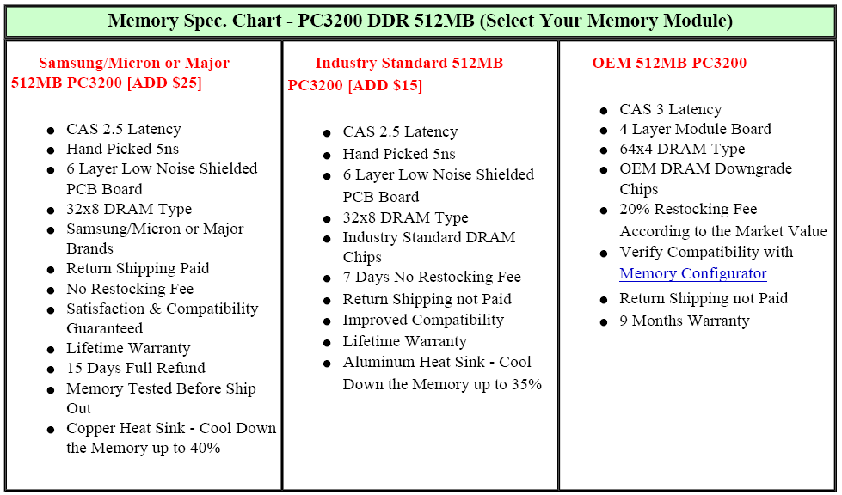
Bait and Switch Tactics
Source: Ellison and Ellison, “Search, Obfuscation … on the Internet” 2009

Slide 7
Platforms and Search
More general problem for e-commerce platforms is that retailers and products are heterogenous.
  Depending on type of good, search problem can be relatively structured (e.g. looking for a new iPad), to quite unstructured (looking for SF Giants memorabilia).
  Sellers can also be heterogeneous: highly so on eBay or Craigslist, significantly less so on Amazon.
Platform faces several interesting problems
  How to structure the search process
  How to provide relevant information to buyers
  How to charge buyers and sellers

Slide 8
Structuring the search process
Emphasize diversity (a la Craigslist, old eBay)
  Traditional eBay search brought up page of listings, organized by auction ending time.
  Similar items might look very different – sellers have an incentive to emphasize diversity!
“Conflation” (a la Amazon, eBay more recently)
  Search for product, product is displayed
  Sellers, and seller distinctions revealed later.
What are the trade-offs? Do they depend on the nature of the item and perhaps buyer?

Slide 9
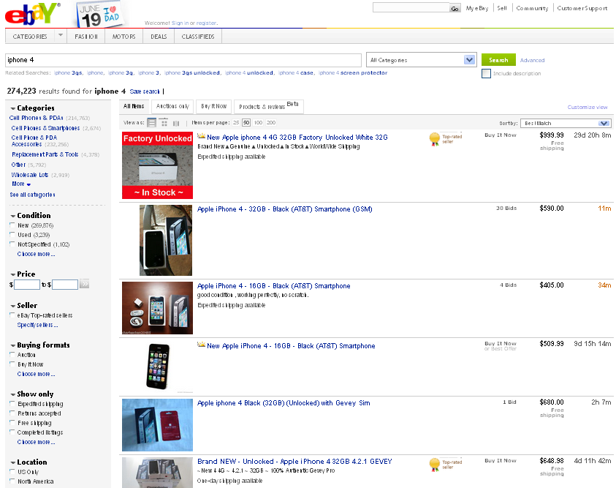

Slide 10
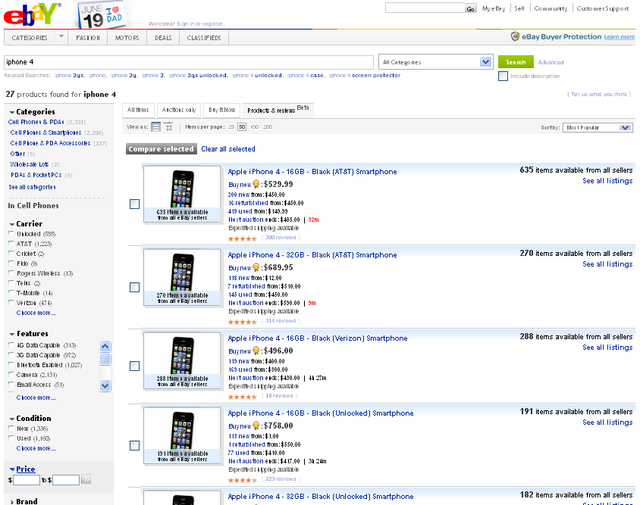

Slide 11
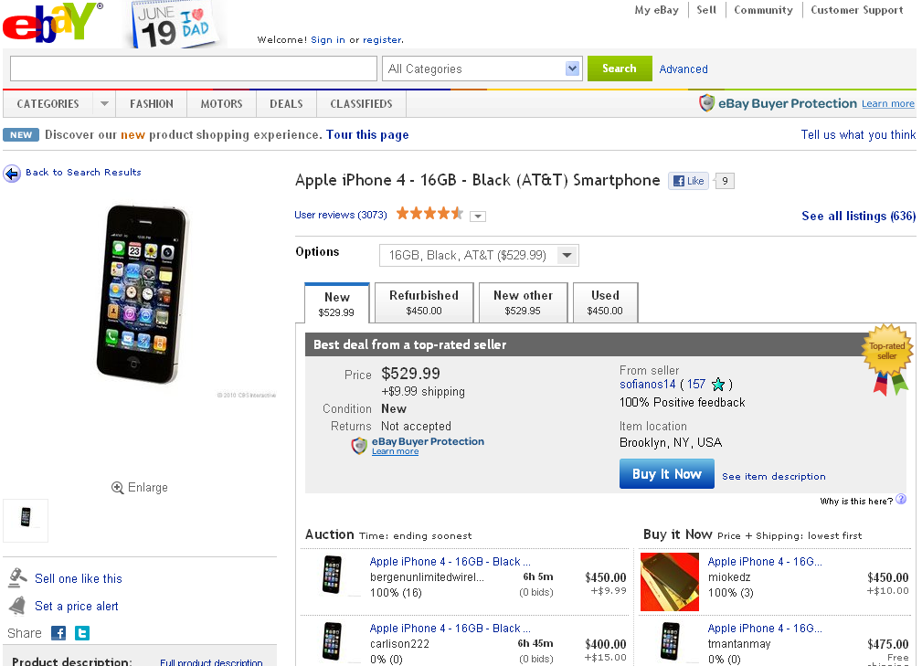

Slide 12
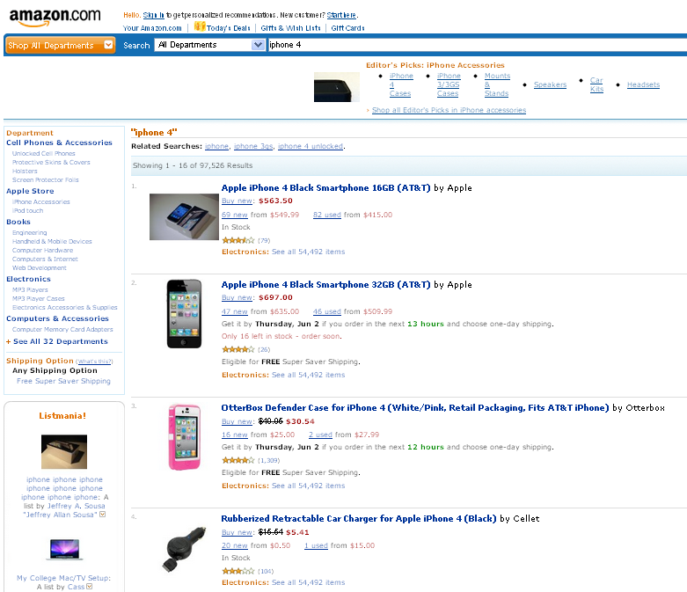

Slide 13
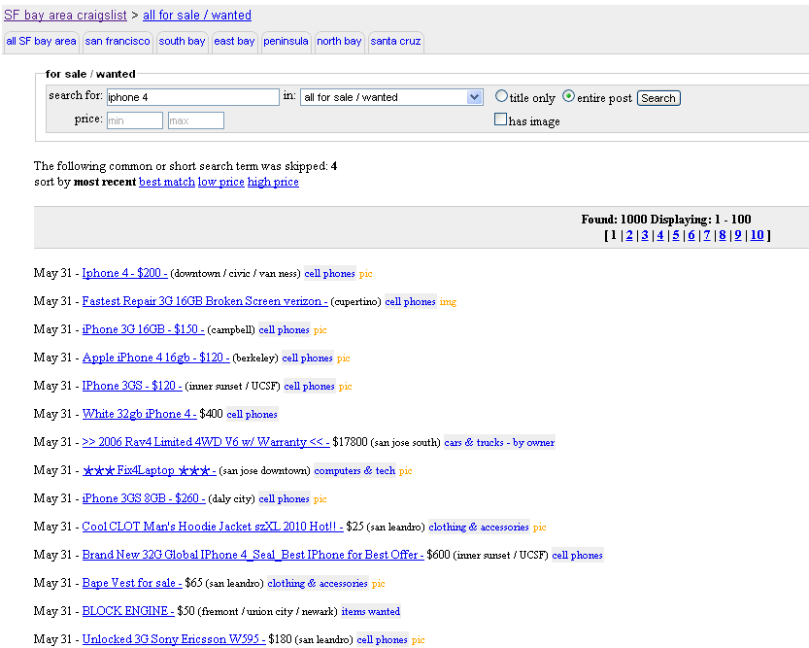

Slide 14
Listings and Information
Buyers and sellers may have very different preferences about how search is structured
  Buyers want queries to generate relevant listings, organized to facilitate quick and accurate comparisons.
  Often this means eliciting from sellers an accurate description of exactly what they are selling.
  Sellers might prefer listing products to be easy (not time-consuming), and to have buyers steered toward them rather than to a head-to-head seller comparison.
Different platforms take very different approaches!

Slide 15
Providing Information
Broader dimension of consumer search would include other types of information to steer buyers.
  Recommendations: “people who bought this also …”
  Product reviews: by experts or by other users.
Mechanism design perspective (more on this later)
  How to provide incentives for users to supply relevant information for other users, and do so accurately?
Platform competition perspective
  Platforms get competitive advantage from being able to use data they collect from today’s users tomorrow.
  Often try to facilitate this “passive” data collective with active experimentation (something that isn’t easy offline).

Slide 16
Platform Fees
What is the optimal way for platforms to charge buyers and sellers for facilitating trades?
  Platform pricing model says to charge users who: (1) create negative network effects; (2) are more price inelastic. Platforms typically charge sellers.
What is the optimal fee structure?
  Many are possible: price per listing, per click, or per sale. All are used to some extent. Why?
  Examples: eBay Motors has price per listing, price comparison engines charge per click, Amazon and most of eBay charge per sale (commissions).

Slide 17
Sales Mechanisms
Internet commerce has allowed a variety of creative selling mechanisms to flourish, e.g. consumer auctions, group buying mechanisms, etc.
Why might the internet favor auctions? Generally,
  Auctions are good for price discovery and they force buyers to compete for unique or idiosyncratic items.
  But not particularly convenient: auctions take time, lack “immediacy” for buyers, plus might not win if you bid.
Internet reduces some of these “transaction costs”, making auctions easier for both sellers and buyers.
  A similar “transaction cost” story helps explain why the internet might facilitate services like Groupon, others.

Slide 18
Internet Auctions
Key innovation: internet proxy bidding (as on eBay)
  Seller starts auction at a minimum price, with the intention of taking bids up to some time.
  Bidders can sequentially raise the price by bidding, and can submit a “maximum bid”, and let a “proxy” raise bid as necessary to stay in the lead.
  Object awarded to standing high bidder at close.
Auction close can be “hard” or “soft”: hard auction close (eBay) tends to promote “sniping” relative to a soft close (old Amazon auctions, most offline auctions).
  Pierre Omidyar’s Quora post about eBay’s rules.

Slide 19
Decline of Auctions on eBay
For online consumer retail sales, posted prices have become dominant – e.g. Amazon, and now even eBay.

Slide 20
What Killed the Internet Auction?
Changes in consumer preferences?
  Bidding in online auctions used to be highly entertaining compared to other internet activity!
  Recall the popularity and demise of “penny auctions”
Changes in markets?
  Internet reduces cost of auctions, but also easy to find prices of comparable goods; less need for “price discovery”
  Also possible that goods being sold are more standard and higher fraction of professional sellers.
Choice of sales mechanism is seller decision, so interesting to look at which works better.

Slide 21
Distribution of Auction Prices (2003)
Auction prices were not that much lower than posted prices in 2003.

Slide 22
Decline in Distribution of Auction Prices
Auction prices were significantly lower relative to posted prices in 2009.

Slide 23
Growth of the Auction Discount 2003-2009
Notes:
Can construct a similar figure for comparative sale rates, but less of a clear trend.
Can construct a similar figure for comparative sale rates, but less of a clear trend.

Slide 24
Will Consumer Auctions Persist?
For certain types of products or sellers
  On eBay, auctions still account for a significant majority of sales by “consumer sellers”, for sales of collectibles or “idiosyncratic” categories.
To clear a market when a deadline approaches
  In ticket markets, most sales occur at posted prices in weeks leading up to an event, but then market switches to auctions as the event date gets closer (Sweeting, 2010).
More surprisingly … for price discrimination?
  Sellers often use posted prices and auctions for the same product. Why? Maybe offer convenience to some buyers, and discounts to others willing to spend a week bidding.

Slide 25
Trust in Online Markets
Problem in internet markets: What am I buying? Can I trust the person with whom I’m trading?
Is this problem worse online than offline?
  Offline it can often be easier to inspect goods, and trade might be more likely to be face-to-face.
  Online trade can be long-distance (eBay, online “task” markets), or initially anonymous (Craigslist, dating sites), and often trades are “pay first, take delivery later”.
Jin-Kato (2007) experiment: buy baseball cards online and offline and have them graded; compare the degree of misrepresentation by sellers.

Slide 26
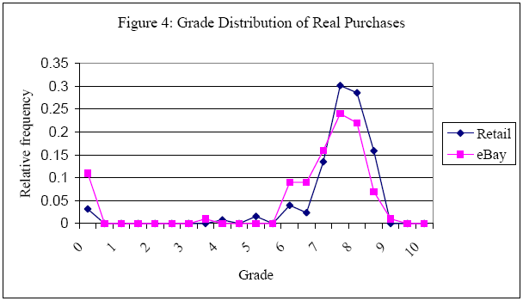
Jin-Kato Baseball Card Experiment
Source: Jin and Kato “Dividing Online and Offline” (2007)

Slide 27
Solutions to the Trust Problem
Third party verification or participation
  Amazon fulfillment for non-Amazon sellers
  Taobao escrow service: pay only after delivery.
  eBay/Paypal buyer money-back guarantee.
Online reputation mechanisms
  Elicit and aggregate user feedback
  Transmit the information to subsequent users
  eBay and Amazon systems are typical.
Issues are similar to the search problem, want to steer buyers to the “right” sellers and provide sellers & buyers with incentives to behave well.

Slide 28
eBay Feedback System
Mechanics of eBay’s feedback system
  After transaction, buyer & seller can submit feedback (positive, negative, neutral), and text (“AAA+++ seller”).
  Future buyers and sellers can observe number of feedbacks, percent “positive”, and can access text as well.
First question: will anyone bother?
  Yes, about 70% of traders provide feedback!
  But, … almost 99% of feedbacks are positive!
Grade inflation means you can sort out who has more experience (number of past sales), but can’t easily tell who has offered a better experience.

Slide 29
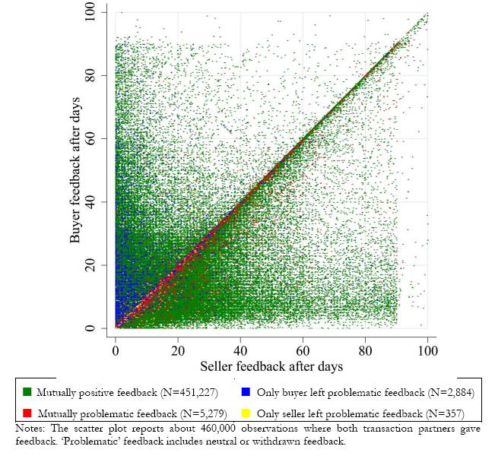
Retaliation in eBay Feedback

Slide 30
Diagnosing the Problem
One problem appears to be fear of retaliation that limits incentive to give negative feedback.
How can you avoid the “retaliation” problem?
  Don’t let sellers give feedback at all (one-sided)
  Don’t let buyer/seller see each other’s feedback
What would be the best fix for eBay?
  Many online sites have one-sided feedback (e.g. Amazon sellers, but not buyers get feedback).
  But eBay community used to feedback system, so instead, as “blind” buyer feedback with more details.

Slide 31
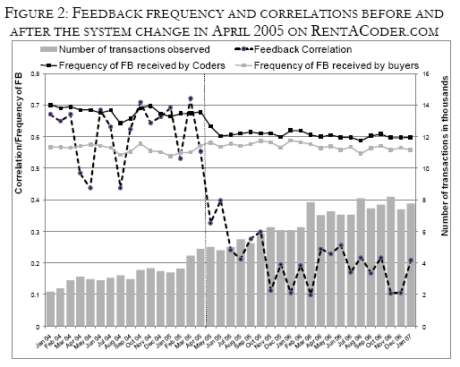
Is Blind Feedback Better?
Source: Bolton et al. “Engineering Trust” (2009)

Slide 32
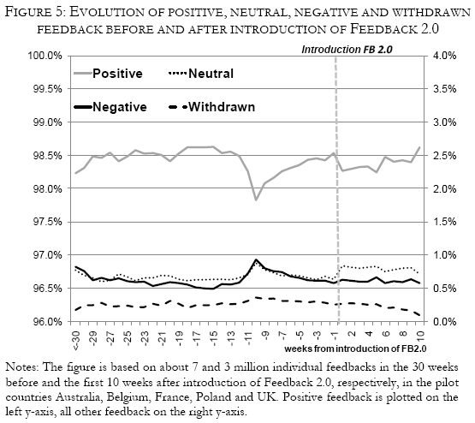
Pilot of eBay Feedback 2.0
Source: Bolton et al. “Engineering Trust” (2009)

Slide 33
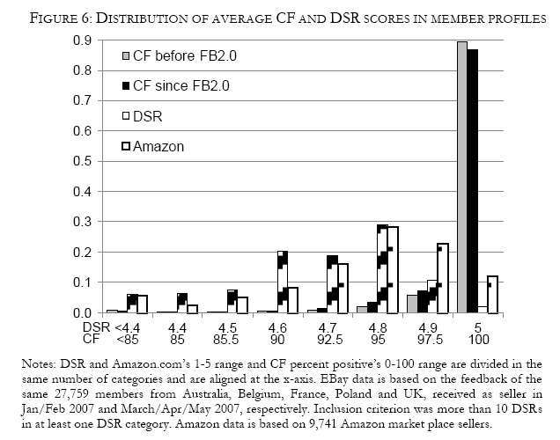
eBay’s Addition of DSR Scores
Source: Bolton et al. “Engineering Trust” (2009)

Slide 34
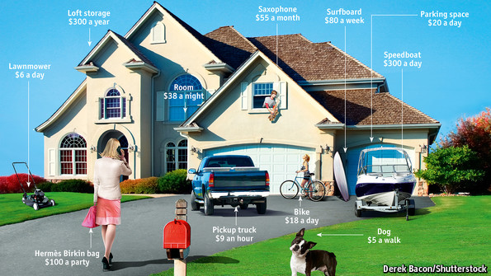
Peer-to-Peer Markets
From the Economist, March 9, 2013

Slide 35
Peer-to-Peer Markets
Idea: under-utilized assets (apartments, cars, stuff in people’s garages, time of under-employed workers), creates opportunities for trade + internet allows creation of marketplace to identify these trades.
Craigslist and eBay were early examples, but lately has been a very popular idea
  Airbnb for apartment rentals
  UberX and Lyft for ride-sharing
  TaskRabbit, oDesk, Mechanical Turk for work.
Consider how three issues above: search + matching, pricing and trust are solved in these examples (or not solved).

Slide 36

Airbnb

Slide 37
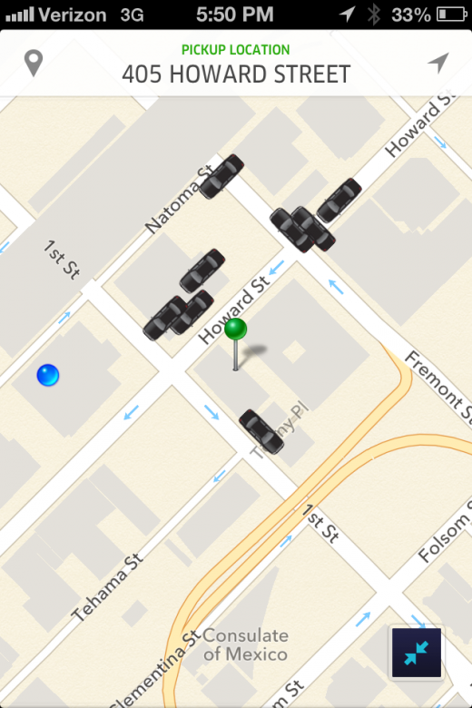
Uber

Slide 38
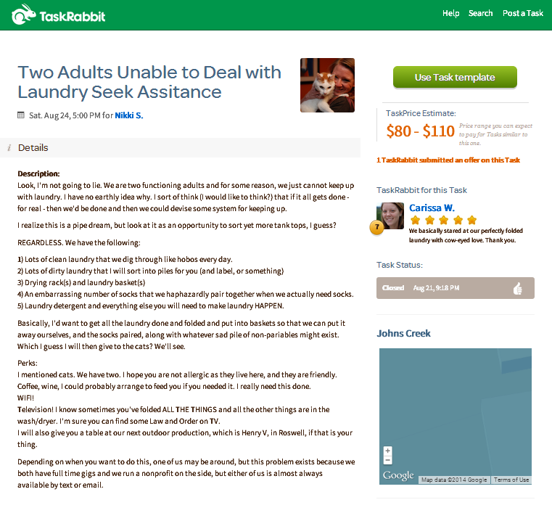
Online Labor Markets

Slide 39
Summary
Focused on three central issues in market design for platforms, apart from attracting buyers and sellers.
  Search, matching and competition: organization of search lets buyers find what they want and creates incentives for sellers to compete – a critical function on all platforms.
  Sales mechanisms: internet reduces costs of using innovative sales mechanisms (auctions, discounts, etc.), but their success has not always persisted.
  Promoting trust with long-distance and semi-anonymous trade: solutions can range from direct intervention (Amazon fulfillment) to more online reputation mechanisms.

